Slide 1

Exploring Political Polarization through Reddit
LSE Data Science Society Team 3

Slide 2
Table of Contents
1. Introduction
2. Motivation / Objectives
3. Data Acquisitions
4. Key Insights
5. Prediction Model: Classifier
6. Interpretation

Slide 3
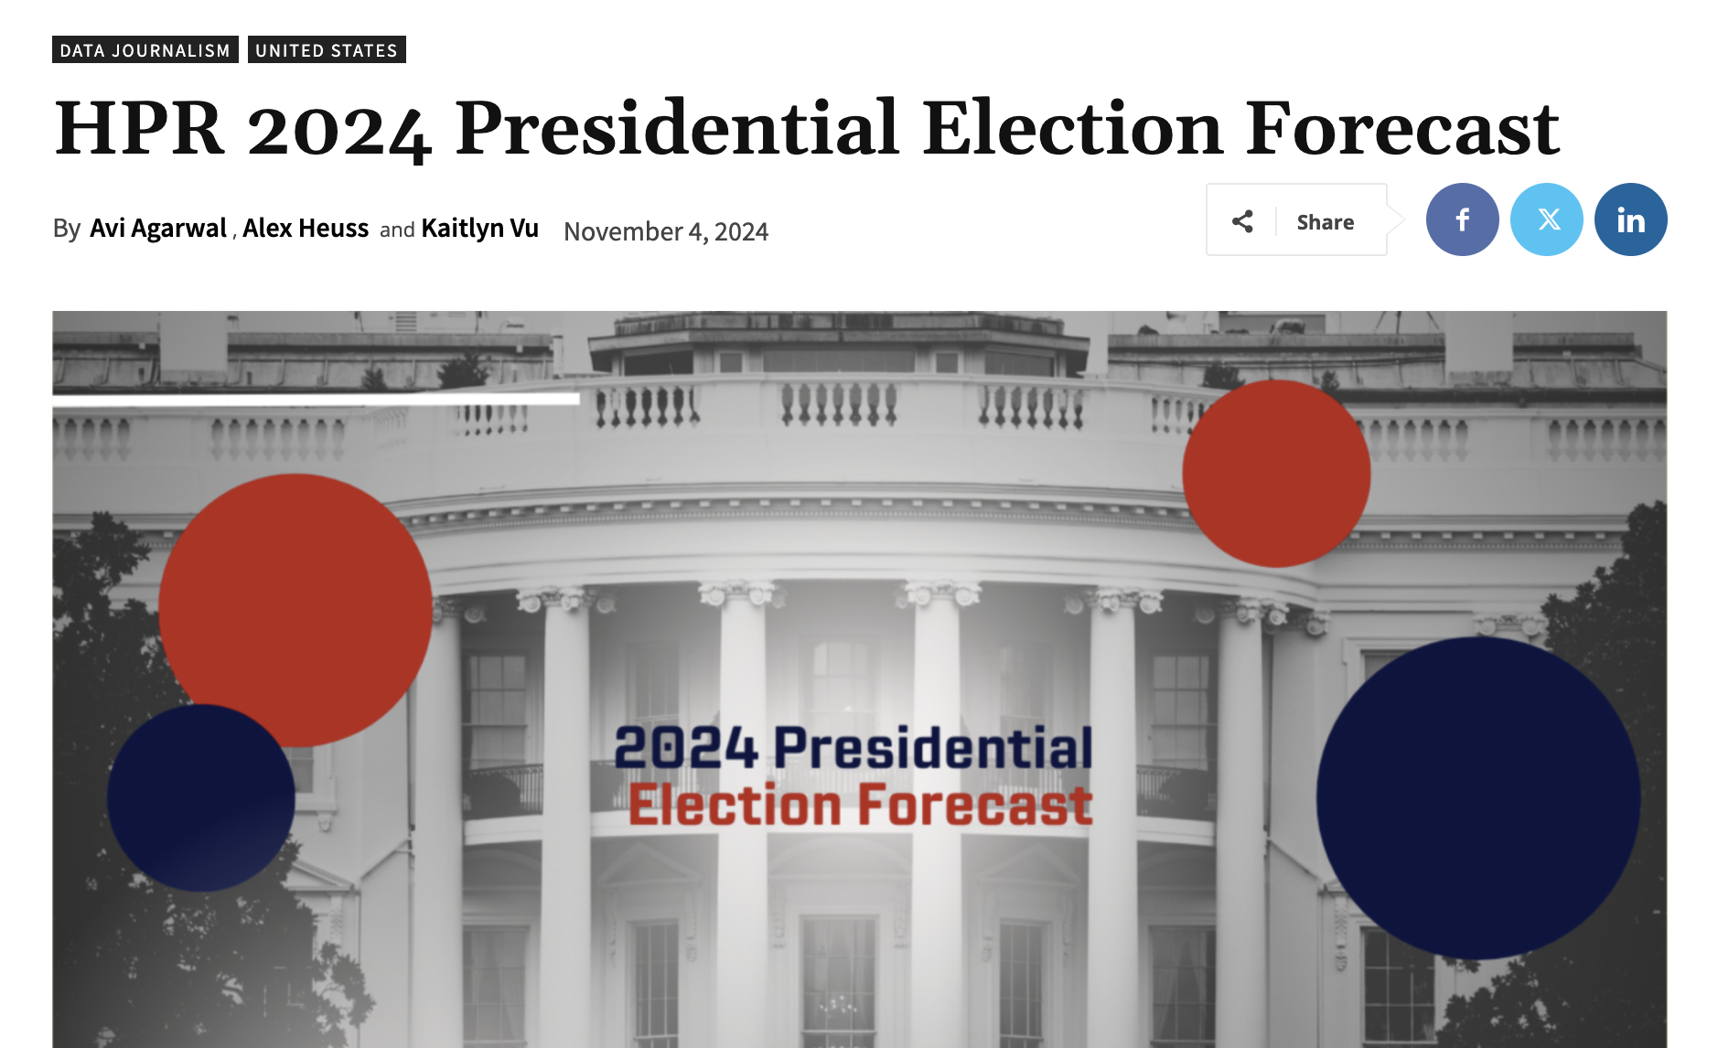
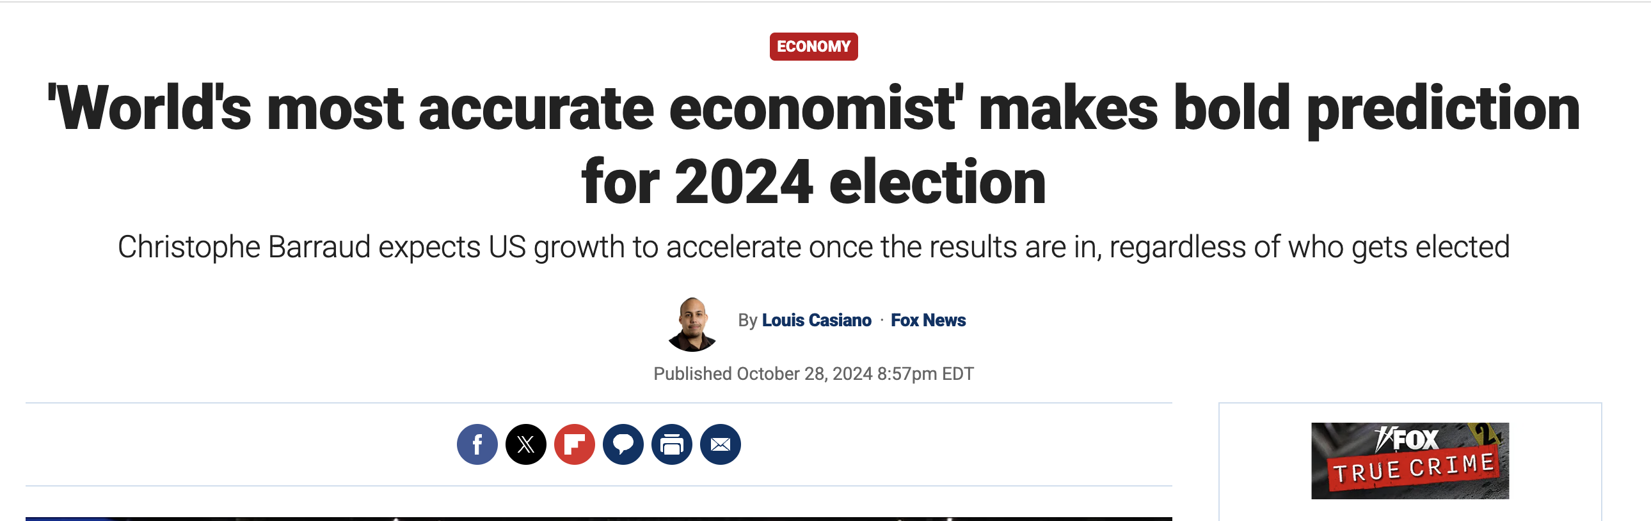
Ideology Drives Polarization in Media
The Harvard Political Review, one of the leftist media, forecasted Harris securing the national popular vote by a margin of approximately 52% to 48%, translating to 319 electoral votes over former President Donald Trump's 219.
The "world’s most accurate economist” from the Fox News is predicting an Election Day victory for former President Trump, with Republicans also predicted to take back control of Congress in a "clean sweep."

Slide 4
(example of polarized reaction to same scandal from leftist/rightist news)

Slide 5
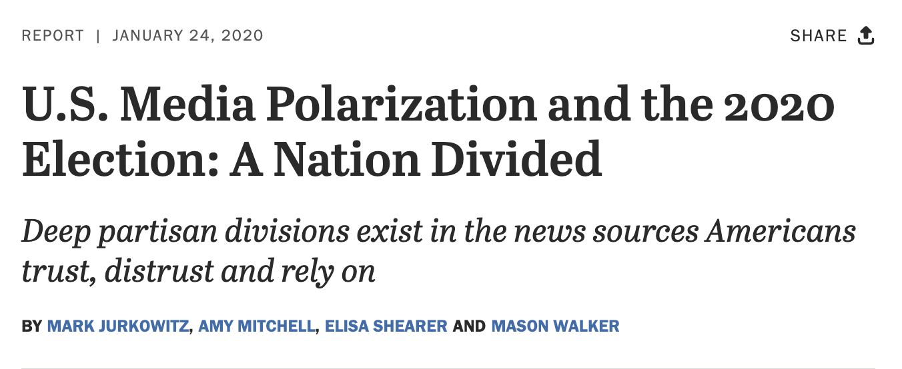

Slide 6
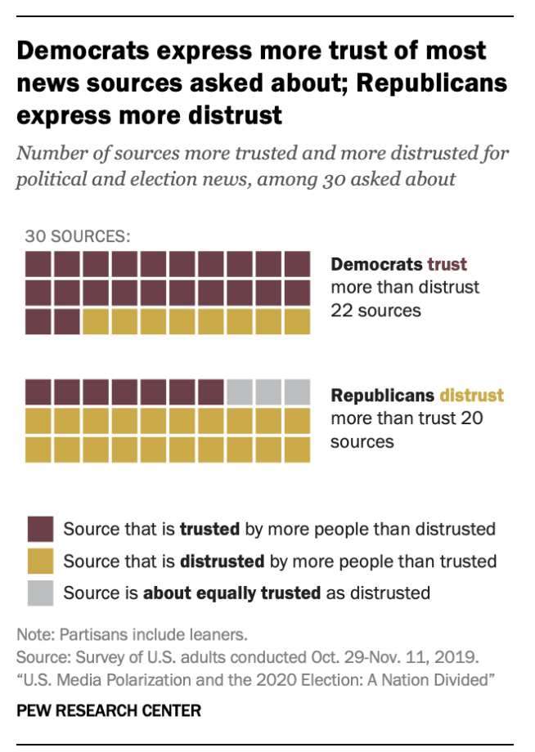
Ideology Drives Media Credibility Polarization
Trust in Media is Divided
Democrats trust a wide range of news sources, while Republicans distrust many of the same outlets (Pew Research Center).
Polarization is Growing:
The gap in media trust between political groups has widened significantly, reflecting increasing ideological divides.
Impact:
Different groups rely on distinct sources, leading to divergent views and reinforcing partisan echo chambers.

Slide 7
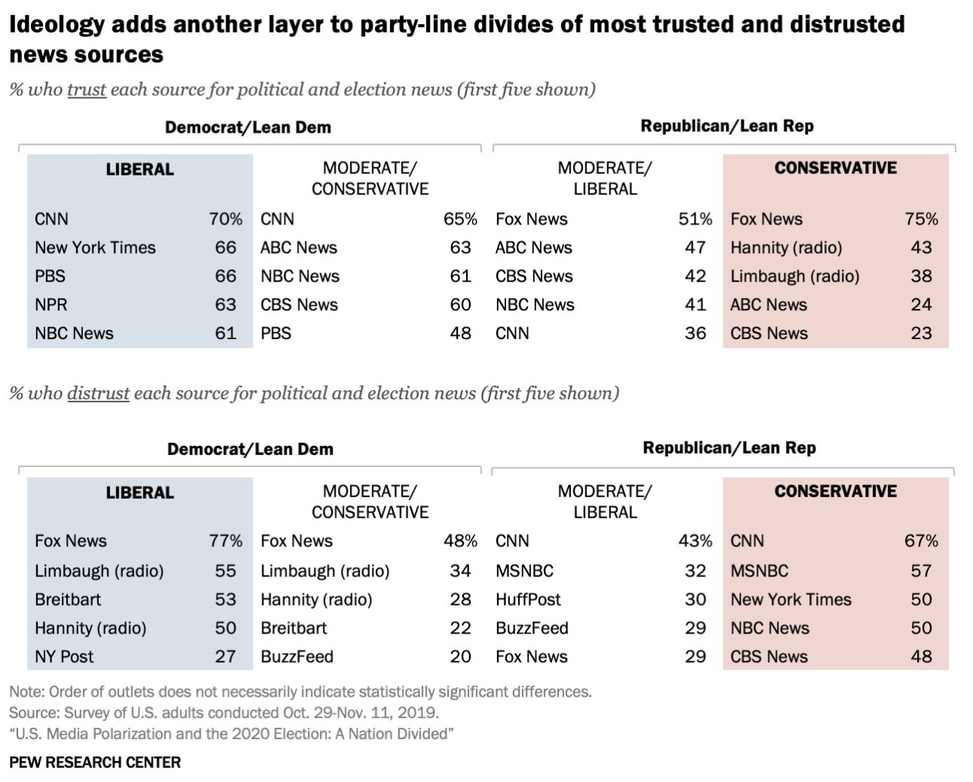
About two-thirds of liberal Democrats (66%) trust The New York Times, for example. In comparison, just 10% of conservative Republicans trust the Times, while 50% outright distrust it.
Rush Limbaugh, meanwhile, is the third-most trusted source among conservative Republicans (38%) but tied for the second-most distrusted source among liberal Democrats (55%).

Slide 8

Motivation
Investigate the extent of polarization between two ideologically distinct communities on Reddit (subreddit) : 'democrats' and 'republicans'

Slide 9
Objectives
Examine News Source Preferences:
Identify the differences in news sources shared and discussed within each subreddit to reflect ideological divides.
Understand Linguistic Differences:
Analyze distinct language patterns and key phrases used by members of each subreddit to highlight their communication styles.
Build a Classifier to Quantify Polarization:
Develop a machine learning model to classify comments, validating the hypothesis that the two subreddits exhibit significant polarization.

Slide 10
Data Acquisition
Time Window:
The year 2024 was chosen as the focus due to the significant event of the U.S. presidential election, but also PRAW only allows recent data.
Data Source:
Data was collected from the 'democrats' and 'republicans' subreddits, two of the most active political communities on Reddit, known for high engagement in terms of upvotes and posts.
Data Collection Method:
Utilized the Python package PRAW (Python Reddit API Wrapper) to fetch data programmatically.
Retrieved 1000 posts from each subreddit, focusing on the "hot" posts, ranked by the number of upvotes and comments.

Slide 11
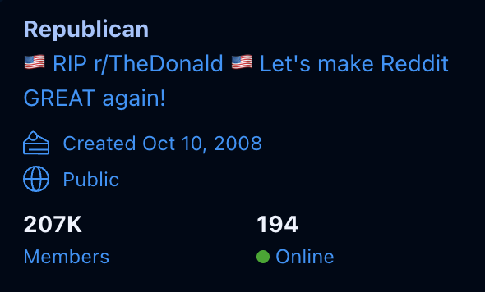
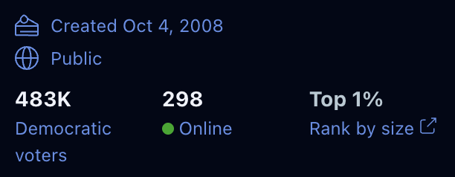



Slide 12
Metadata
Each post includes the following metadata:
Title: The title of the post.
Score: The total upvotes received.
ID: The unique identifier for the post.
URL: A URL for link or image in the post.
Number of Comments: Total comments on the post.
Created: Timestamp indicating when the post was created.
Body: The main content of the post (if any).

Slide 13
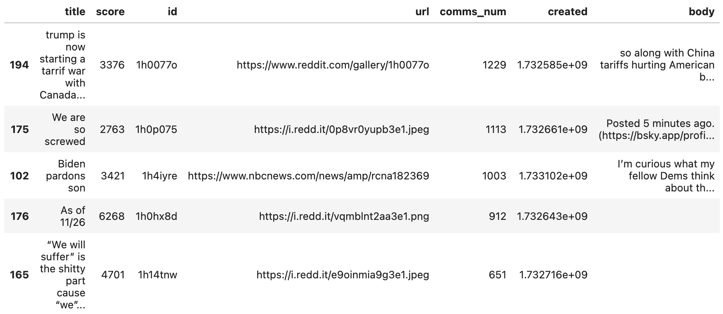

Slide 14
Key Insights 1 : News Sources Analysis

Slide 15
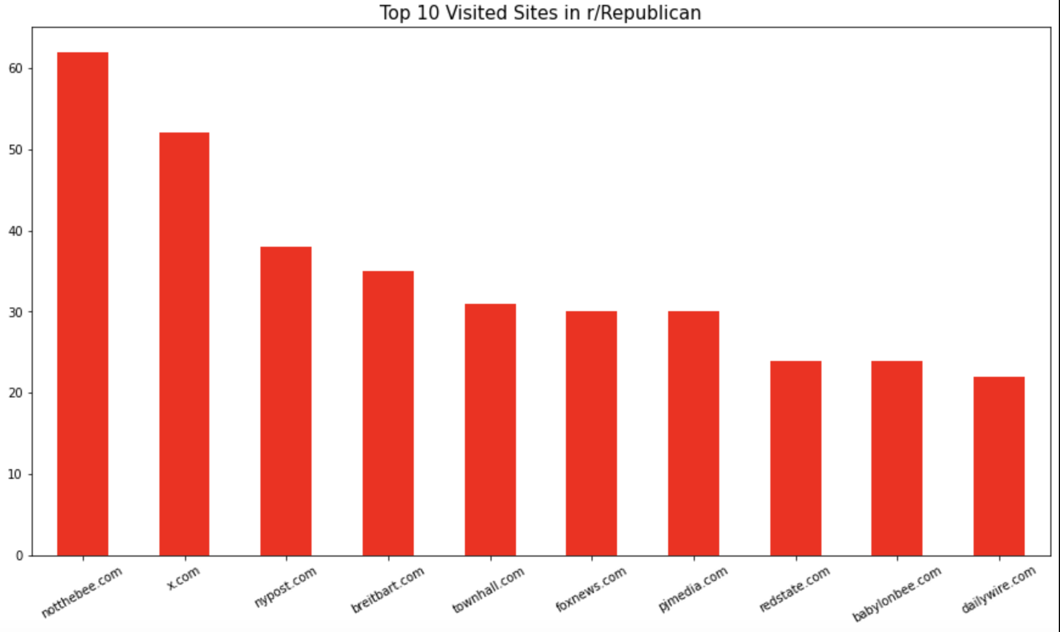
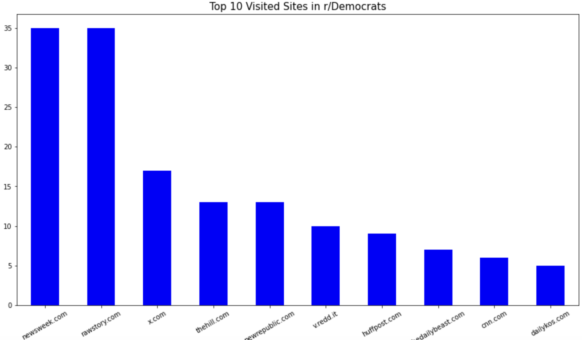

Slide 16
Republicans favor conservative-leaning outlets such as notthebee.com, foxnews.com, and breitbart.com.
Democrats prefer progressive sources like newsweek.com, rawstory.com, and huffpost.com.
x.com (Twitter) is a shared platform, but narratives likely differ between groups.
These preferences highlight ideological polarization and the reinforcement of echo chambers.

Slide 17
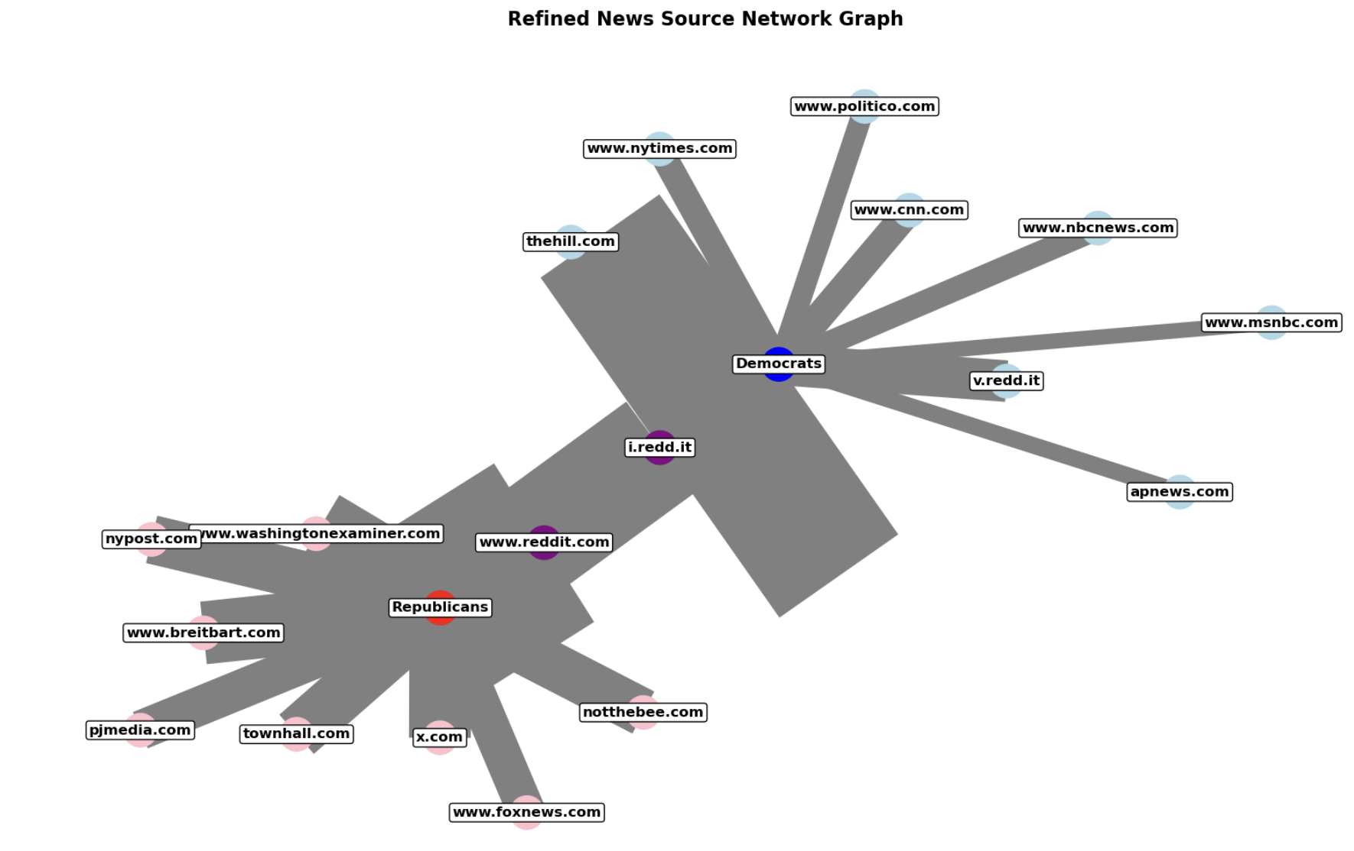

Slide 18
Key Insights 2 : Word Cloud
To visualize the most frequently used words in both subreddits, we created a word cloud using only the titles of posts. The process involved:
1. Combining all post titles into a single text.
2. Tokenizing the text and filtering out non-alphabetic words and custom stopwords.
3. Computing the word frequencies to identify the top 30 most common words.
The resulting word cloud highlights the dominant themes and topics discussed in the subreddit, excluding generic stopwords to focus on meaningful terms.

Slide 19
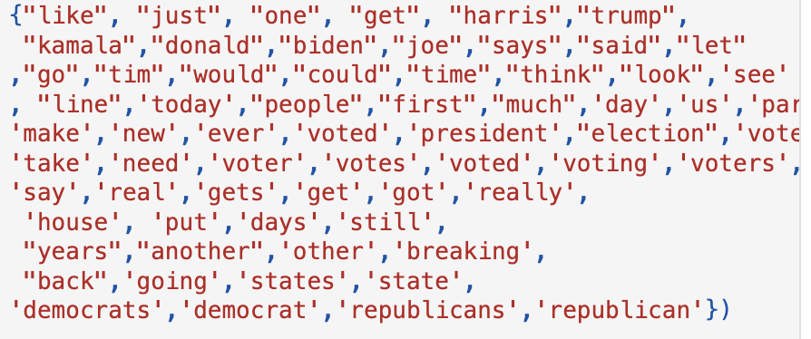
Stopwords we used
To generate meaningful word clouds, we excluded irrelevant words using a custom stopwords list. This list included:
- Common English stopwords provided by the NLTK library.
- Additional domain-specific words frequently used in political discussions (e.g., "Biden", "Trump", "election").
- Punctuation and generic terms that do not add value to the analysis (e.g., "like", "just").

Slide 20
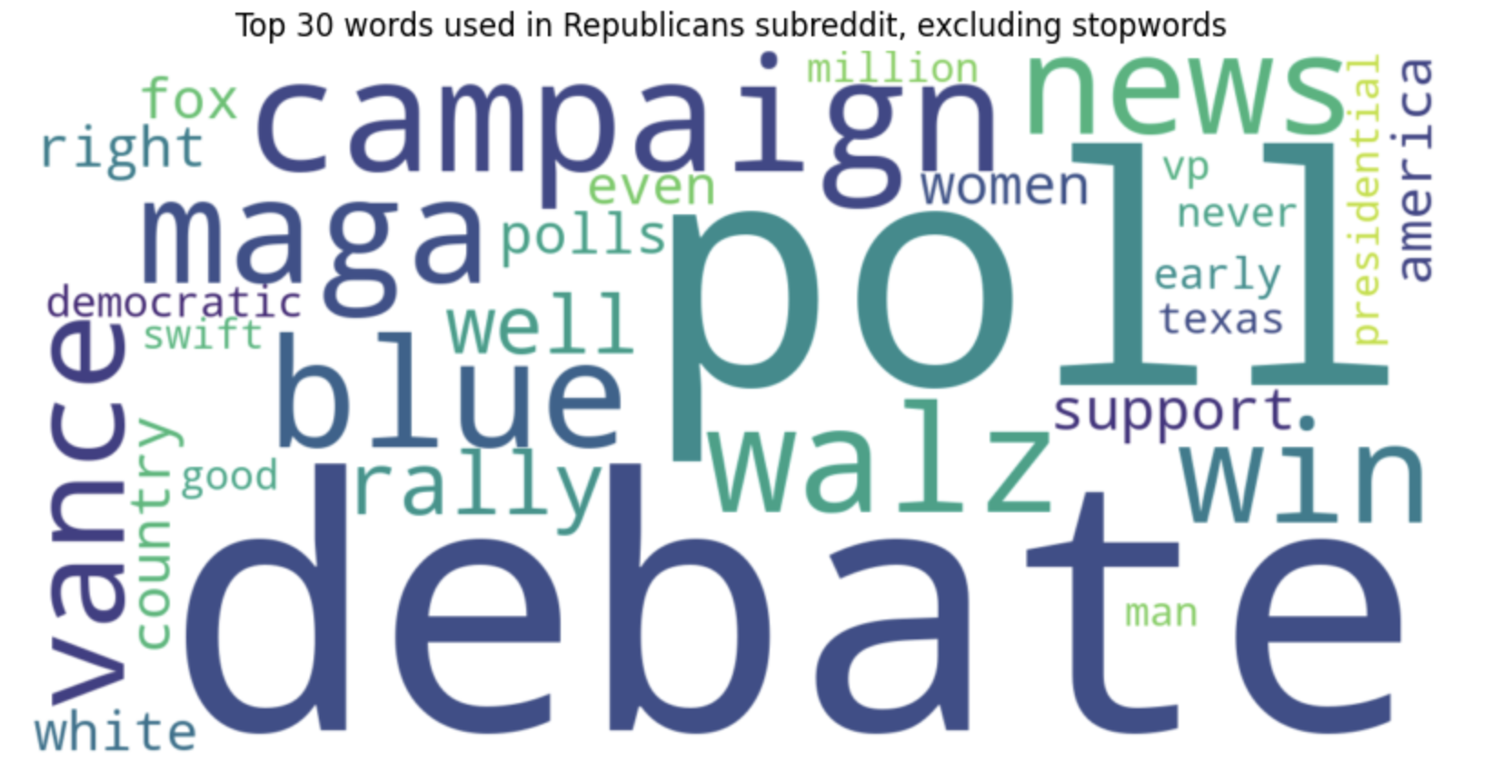

Slide 21
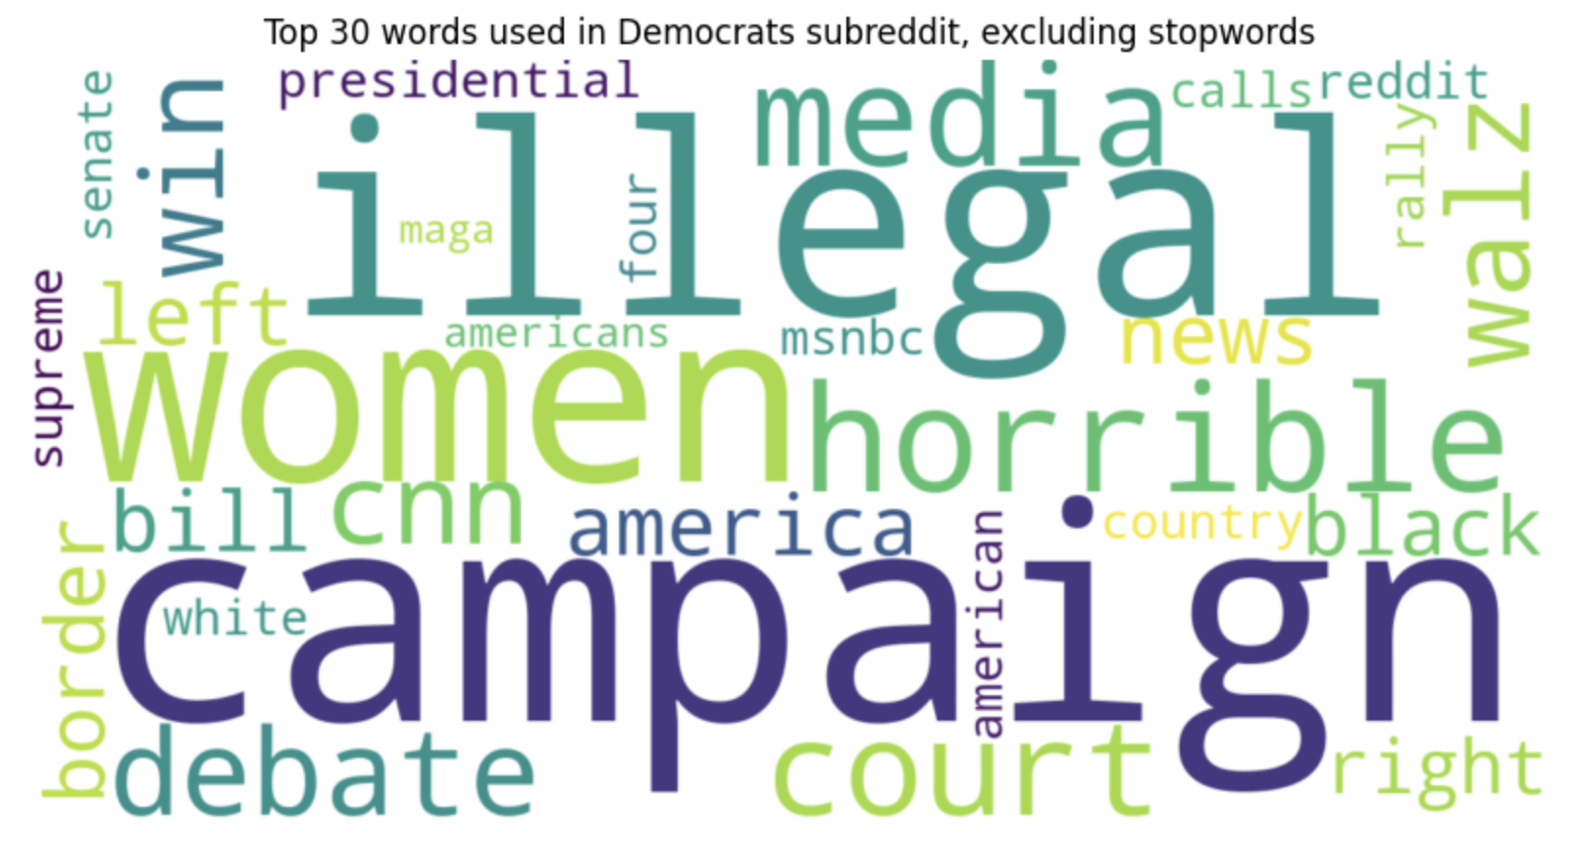

Slide 22
Focus on Key Issues:
The Republicans word cloud emphasizes terms like "poll," "maga," and "debate," highlighting political strategy and campaign events, while the Democrats word cloud includes terms like "illegal," "horrible," and "court," reflecting a focus on criticism of policies and legal issues.
Language and Sentiment:
Republicans use more proactive and optimistic terms like "campaign," "rally," and "win," while Democrats lean towards negative terms like "horrible" and "illegal," reflecting disappointment after the election results.
Common Ground:
Both word clouds prominently feature terms like "campaign" and "debate," showing shared interest in electoral processes despite ideological divides.
Distinct Themes:
The Republican word cloud includes partisan identity markers like "maga" and "blue," whereas the Democratic word cloud features broader concerns such as "media," "women," and "court," potentially addressing post-election issues.

Slide 23
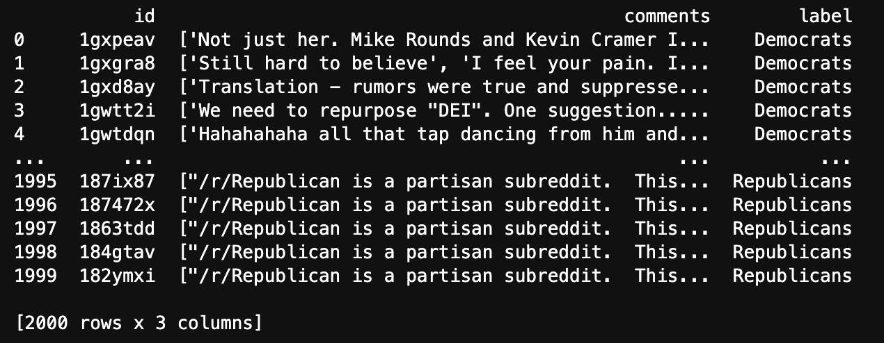
Key Insights 3: Fetching Comments Data
First, every comments from each post will be extracted and labeled as their origin.

Slide 24
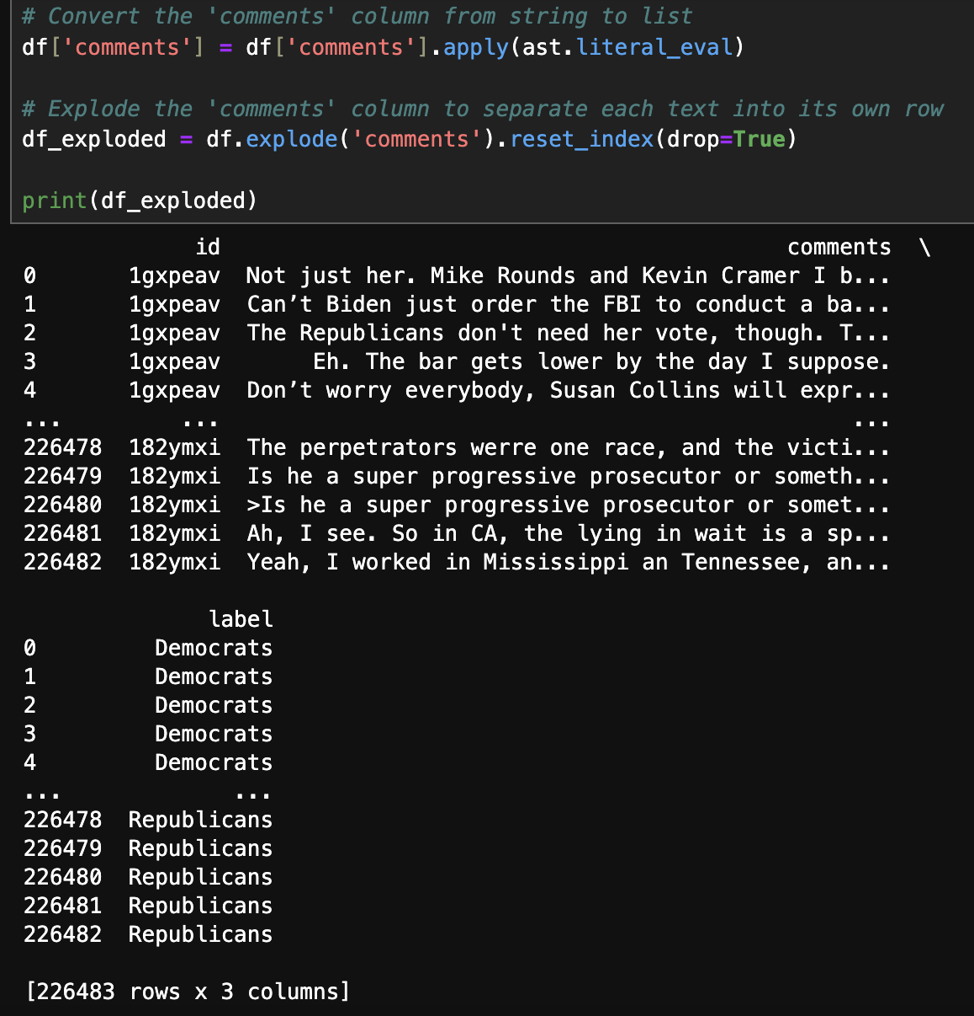
Using explode, divide all the list of sentences into different datapoints.

Slide 25
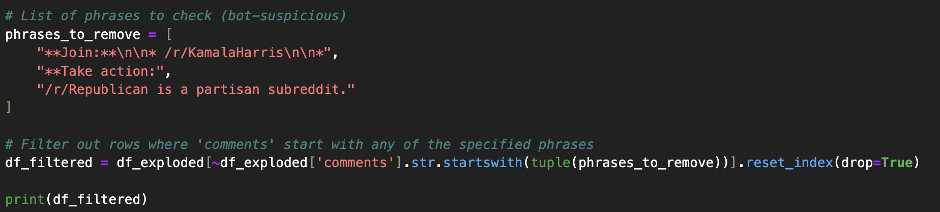
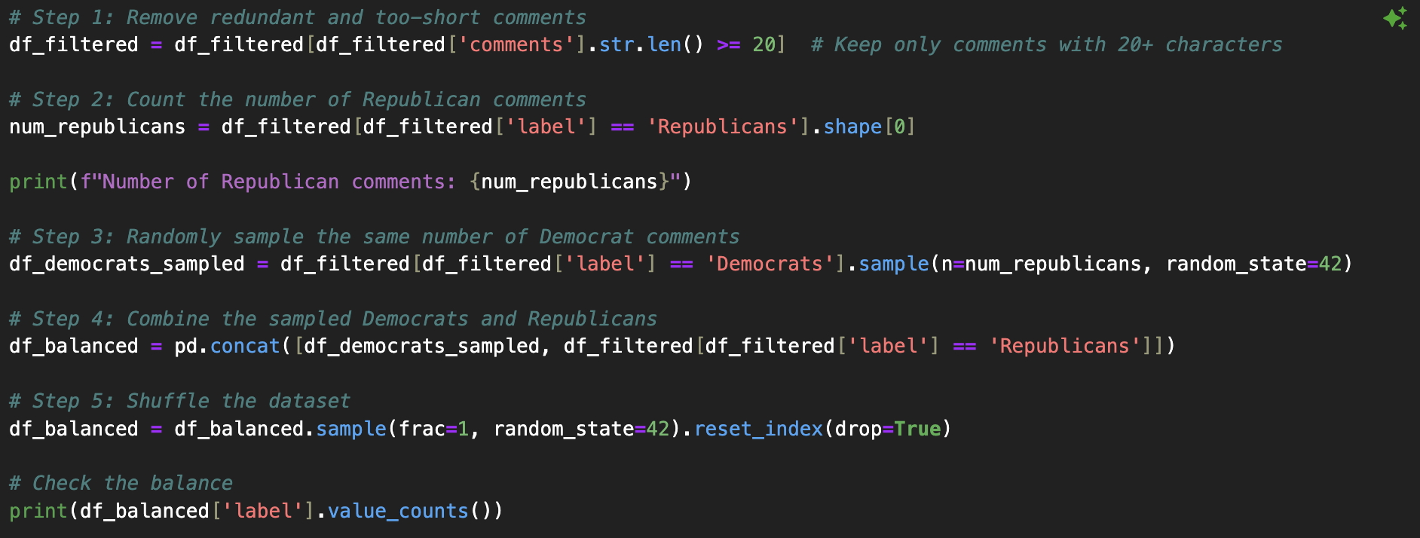
Manually checked bot-suspicious comments and excluded them.
We filtered out comments with fewer than 20 characters to remove redundant or overly short entries. To balance the dataset, we randomly sampled an equal number of Democrat comments to match the count of Republican comments, combined them, and shuffled the resulting dataset.

Slide 26
Comments – Building Classifier
- We utilized TF-IDF (Term Frequency-Inverse Document Frequency) to convert subreddit comments into numerical features, focusing on the top 5000 terms while excluding common stopwords.
- We split the data into training and testing sets to evaluate the model's performance.
- A Logistic Regression classifier was trained using the TF-IDF-transformed data to predict subreddit labels.
- This approach allowed us to effectively capture the importance of terms in distinguishing between comments from the two subreddits.

Slide 27
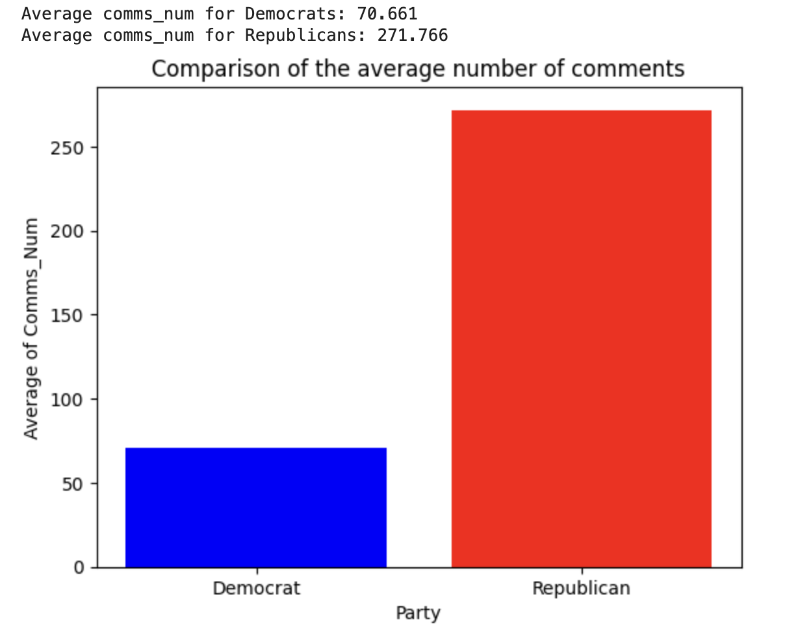
Despite the fact that the Democrats subreddit is much larger, the Republicans subreddit generated significantly more comments, aligning with the success of Donald J. Trump in the presidential election race.

Slide 28
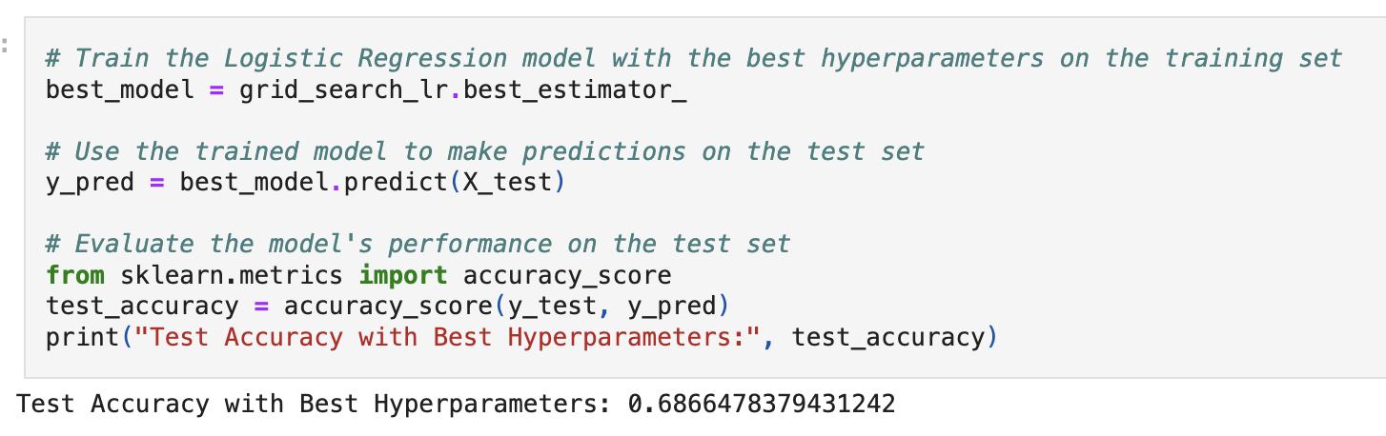

Slide 29
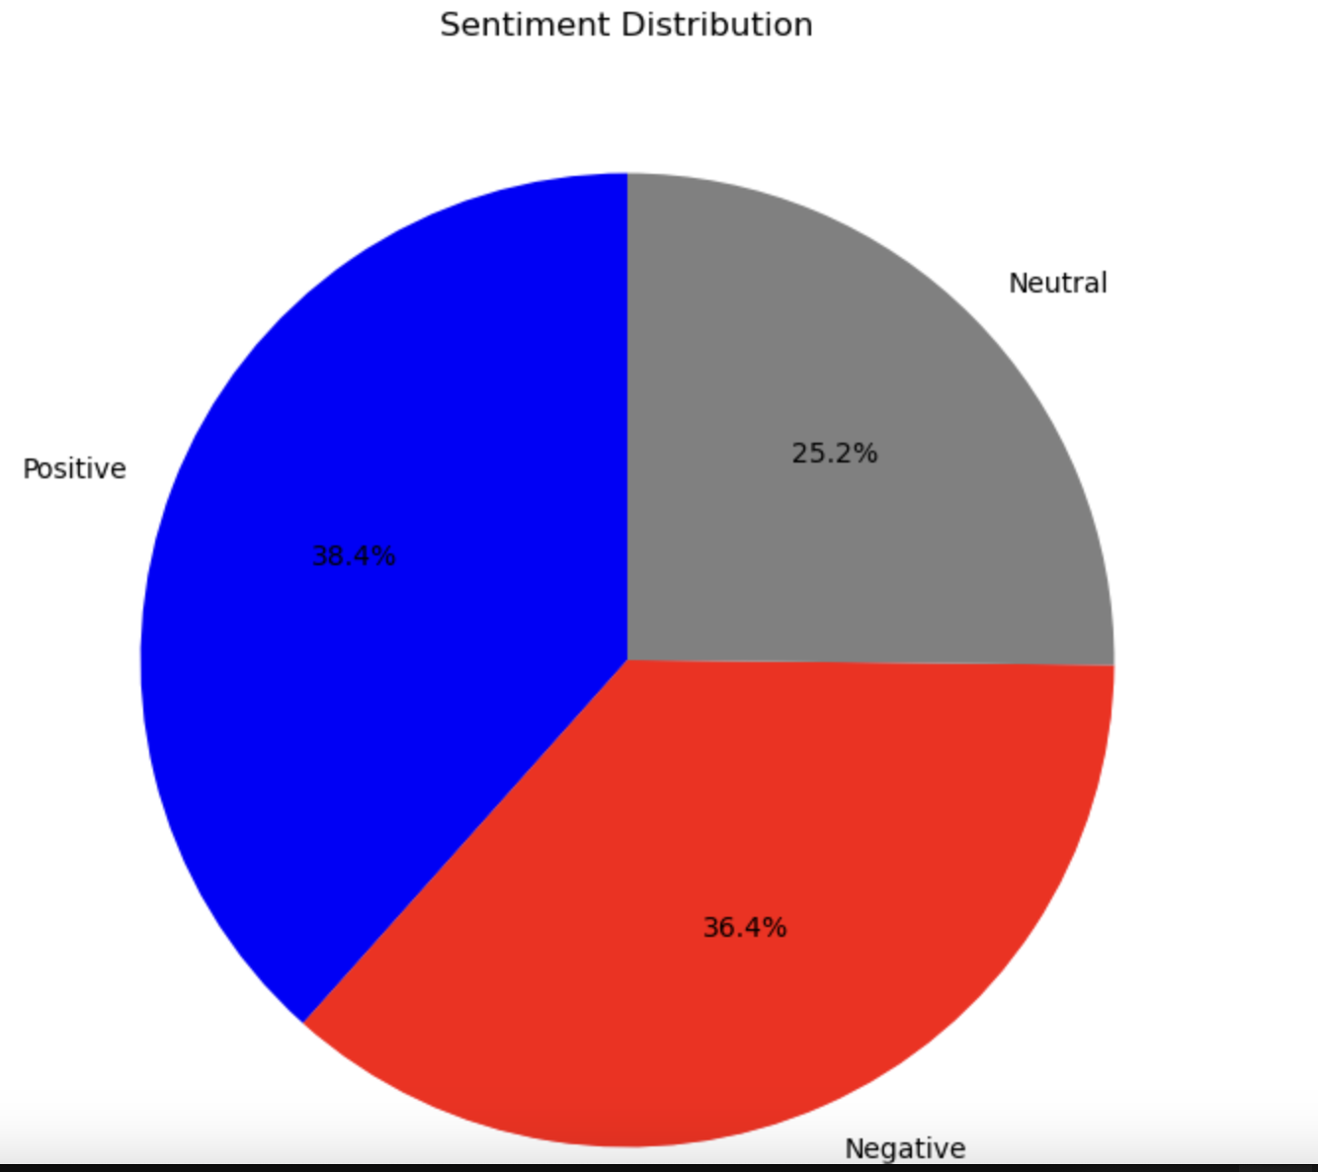

Slide 30
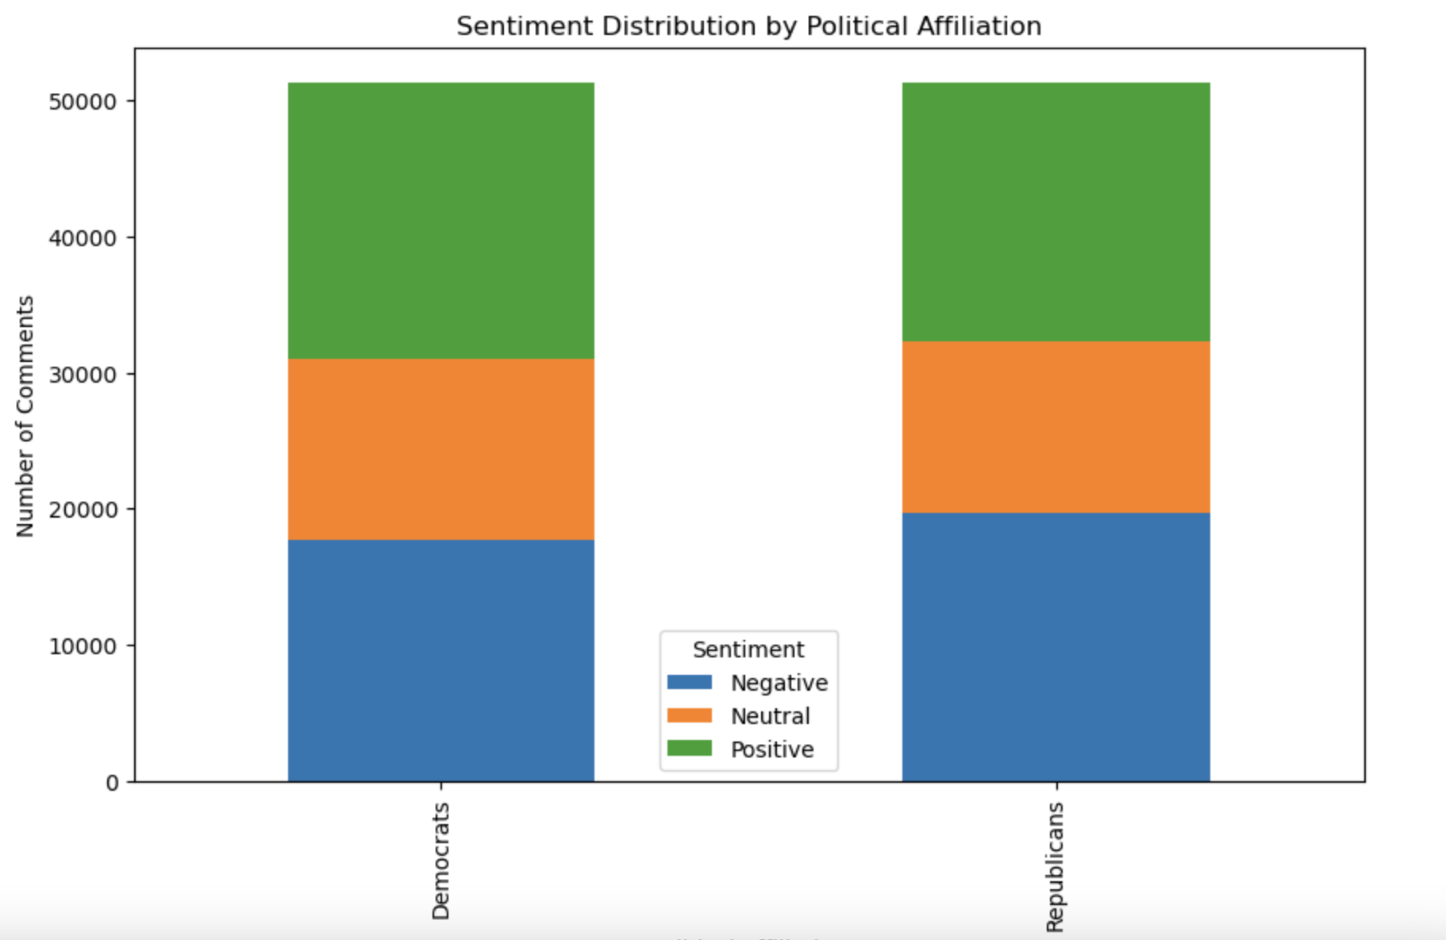

Slide 31
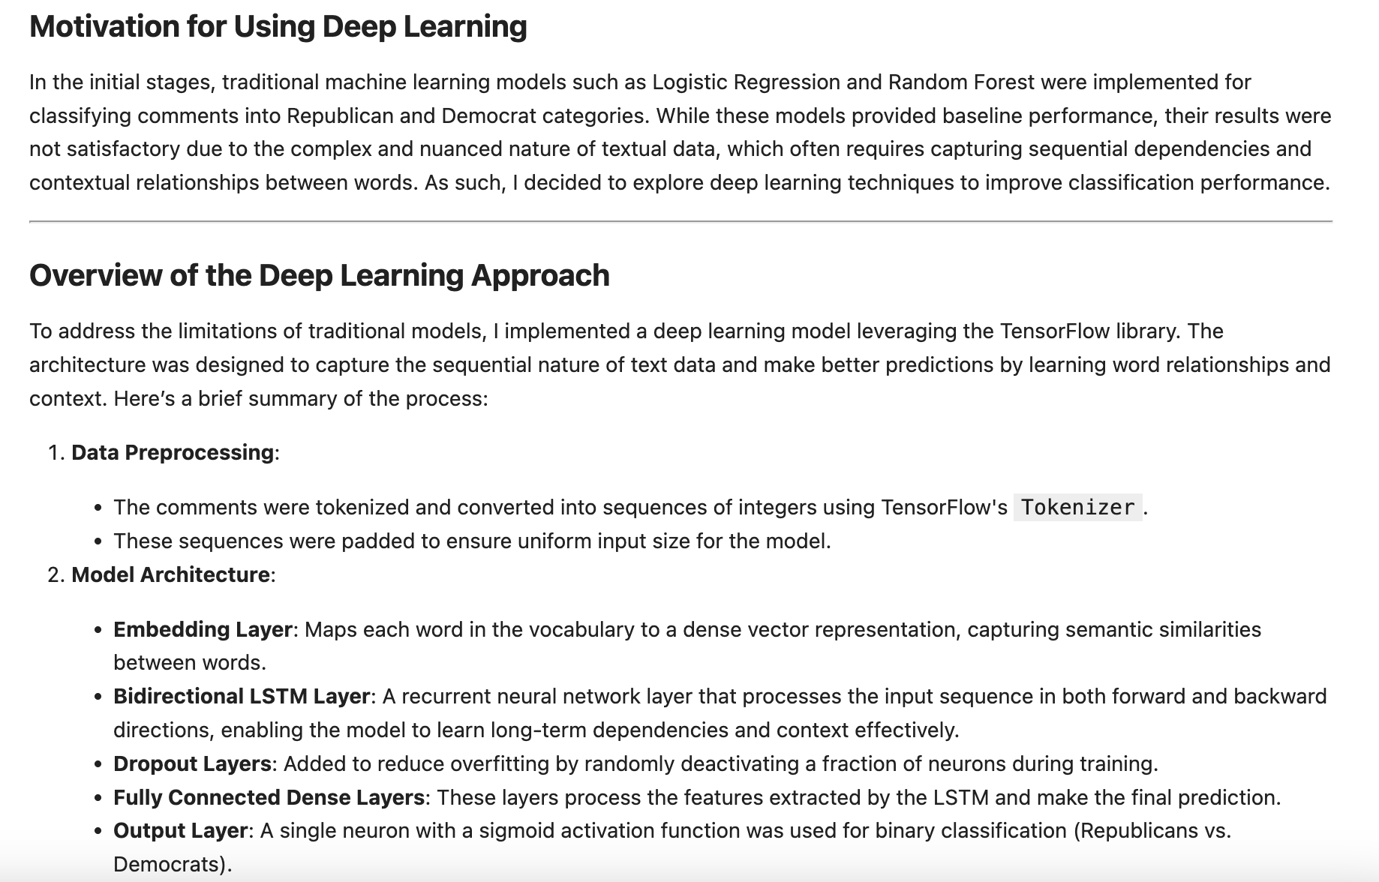

Slide 32
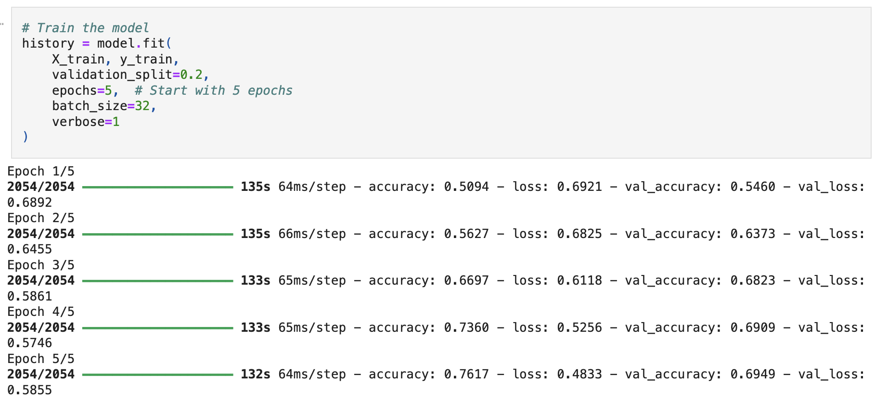

Slide 33
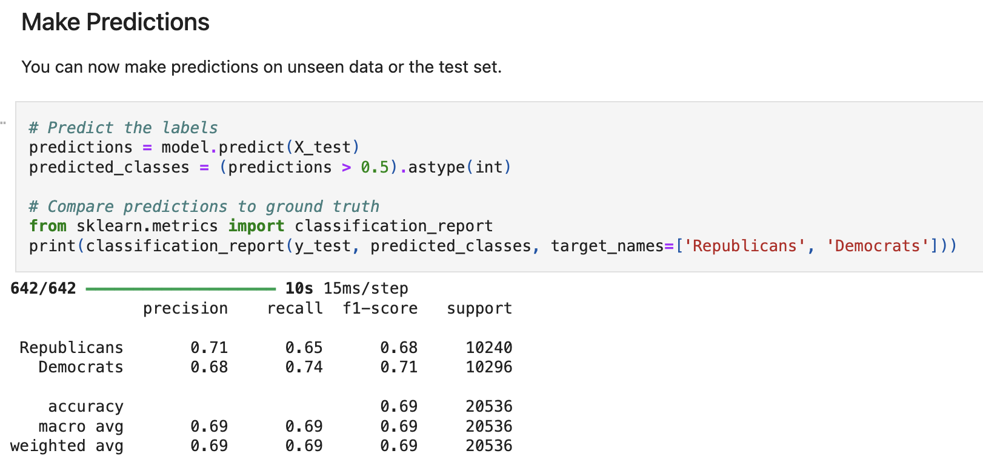

Slide 34
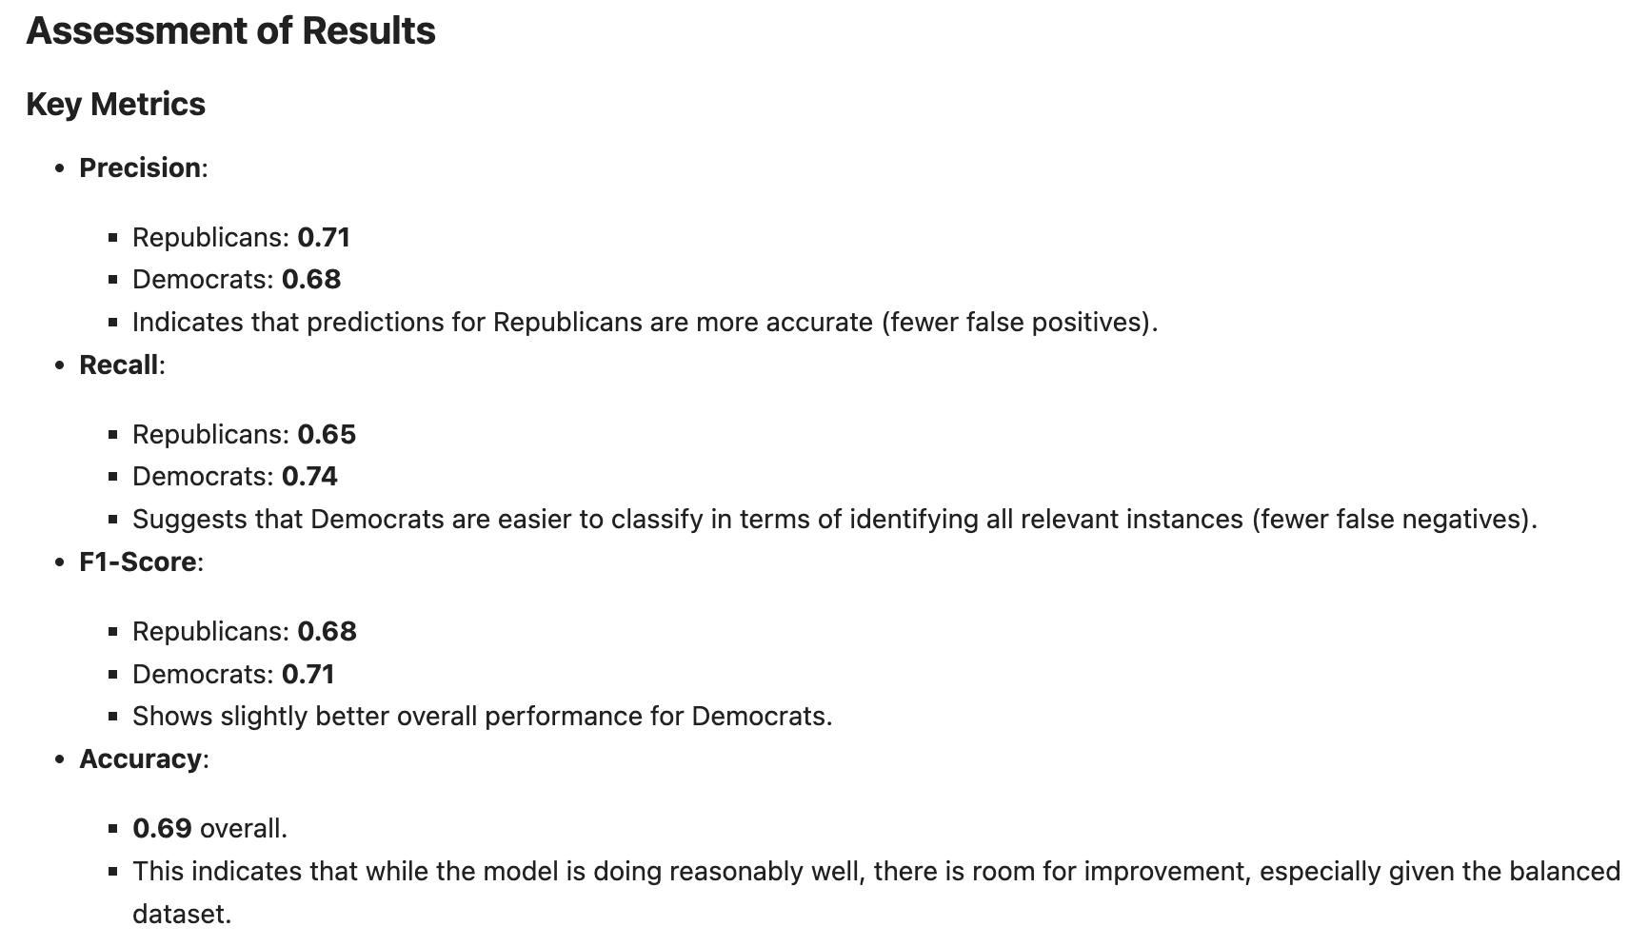

Slide 35
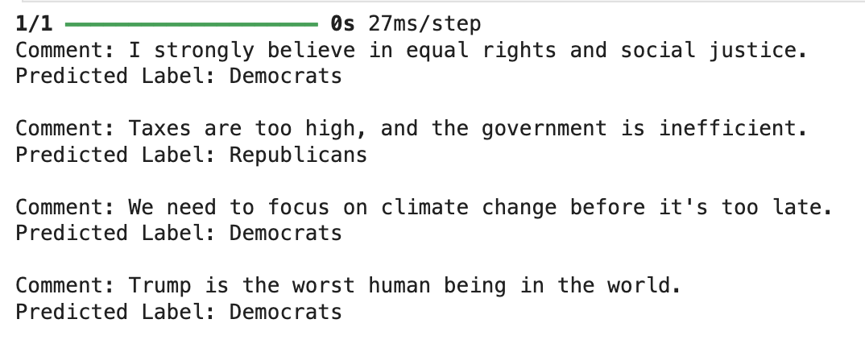
Custom comments are tested

Slide 36
Conclusion

